Slide 1
LIST DATA STRUCTURES
List ADT by array
Dynamic memory
Limitations of array
Implementation of lists
Linked list-singly linked list, doubly linked list, circular (singly and doubly) linked list
Operations on linked list-creation, insertion, deletion, update search, adding new nodes

Slide 2
Linked Lists
Each data item is embedded in a link.
Each Link object contains a reference to the next link in the list of items.
In an array items have a particular position, identified by its index.
In a list the only way to access an item is to traverse the list
Is Linked List an ADT?

Slide 3
Linked List Efficiency
Insertion and deletion at the beginning of the list are very fast, O(1).
Finding, deleting or inserting in the list requires searching through half the items in the list on an average, requiring O(n) comparisons.
Although arrays require same number of comparisons, the advantage lies in the fact that no items need to be moved after insertion or deletion.
As opposed to fixed size of arrays, linked lists use exactly as much memory as is needed and can expand.

Slide 4
Operations in a simple linked list:
Insertion
Deletion
Searching or Iterating through the list to display items.

Slide 5
Array vs Linked List
node
node
Array
node
Linked List

Slide 6
Array versus Linked Lists
Linked lists are more complex to code and manage than arrays, but they have some distinct advantages.
Dynamic: a linked list can easily grow and shrink in size.
We don’t need to know how many nodes will be in the list. They are created in memory as needed.
In contrast, the size of a C++ array is fixed at compilation time.
Easy and fast insertions and deletions
To insert or delete an element in an array, we need to copy to temporary variables to make room for new elements or close the gap caused by deleted elements.
With a linked list, no need to move other nodes. Only need to reset some pointers.

Slide 7
What’s wrong with Array and Why lists?
Disadvantages of arrays as storage data structures:
slow searching in unordered array
slow insertion in ordered array
Fixed size
Linked lists solve some of these problems
Linked lists are general purpose storage data structures and are versatile.

Slide 8
List ADT by array
Using Arrays
Storing objects in arrays is a common use for arrays
Example: we could just as easily have chosen to store records for patients in a hospital or the names of players on a football team

Slide 9
The entries array of length eight storing six GameEntry objects in the cells from index 0 to 5.
Here maxEntries is 10 and numEntries is 6.

Slide 10
ADT Lists
Also called linear list.
Group of items arranged in a linear order.
Operations supported are : insertion, deletion and read an item.
List is defined by its interface; the specific methods used to interact with it.
This can be implemented using arrays or linked lists.

Slide 11
Iterators (ADT)
An iterator is a reference that points to a link in an associated list.
In order to traverse a list, performing some operation on certain links it is efficient to go from one link to another, checking whether each meets the criteria and then performing the operation.
To do this, we need a reference that can be incremented.
This reference can be embedded in a class object.
Objects containing references to items in data structures, used to traverse theses structures are called Iterators.

Slide 12
Operations in a simple linked list:
The simplest methods are
insertfirst() and
deletefirst(),
where the first item in the linked list is accessed and deleted or a new item is inserted as the head or root of the list.
To insert or delete items from any other part of the list, we need to traverse the list starting from its root and traversing till we get the item that we are looking for.

Slide 13
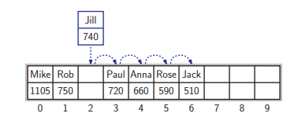
Insertion
The approach is to shift all the entries of the array whose scores are smaller than e’s score to the right, in order to make space for the new entry.

Slide 14
Preparing to add a new GameEntry object (“Jill”,740) to the entries array.
In order to make room for the new entry, we shift all the entries with smaller scores to the right by one position.

Slide 15
After adding the new entry at index 2.

Slide 16
Object Removal
If index i is outside the bounds of the entries array, then this function throws an exception;
Otherwise, the entries array is updated to remove the object at index i and all objects previously stored at indices higher than i are “shifted left” to fill in for the removed object.

Slide 18
Sorting an Array
we consider how to rearrange objects of an array that are ordered arbitrarily in ascending order.
This is known as sorting.

Slide 19
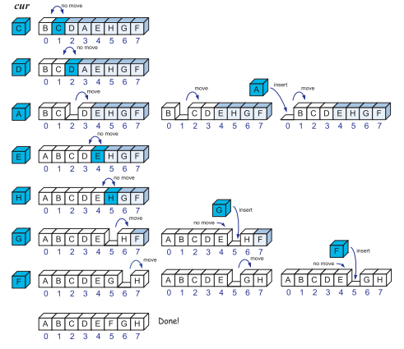

Slide 20
Execution of the insertion-sort algorithm on an array of eight characters.
We show the completed (sorted) part of the array in white, and we color the next element that is being inserted into the sorted part of the array with light blue.
We also highlight the character on the left, since it is stored in the cur variable.

Slide 21
Each row corresponds to an iteration of the outer loop, and each copy of the array in a row corresponds to an iteration of the inner loop.
Each comparison is shown with an arc.
In addition, we indicate whether that comparison resulted in a move or not.

Slide 22
Sorted Lists (ProrityQ)
As the name suggests data is stored in order.
Find and delete methods are used.
Advantage of sorted list over sorted array is speed of insertion and its ability to expand to fill available memory.
Efficiency:
-- Insertion and deletion of arbitrary items require O(n) comparisons.

Slide 23
Pointer Implementation (Linked List)
Ensure that the list is not stored contiguously
use a linked list
a series of structures that are not necessarily adjacent in memory
Each node contains the element and a pointer to a structure containing its successor
the last cell’s next link points to NULL
Compared to the array implementation,
the pointer implementation uses only as much space as is needed for the elements currently on the list
but requires space for the pointers in each cell

Slide 24
Linked Lists
A
B
C
∅
Head
A linked list is a series of connected nodes
Each node contains at least
A piece of data (any type)
Pointer to the next node in the list
Head: pointer to the first node
The last node points to NULL
node
A
data
pointer

Slide 25
Linked Data Structures
A linked data structure consists of items that are linked to other items
How? each item points to another item
Singly linked list: each item points to the next item
Doubly linked list: each item points to the next item and to the previous item

Slide 26
Conceptual Diagram of a Singly-Linked List
front

Slide 27
Advantages of Linked Lists
The items do not have to be stored in consecutive memory locations: the successor can be anywhere physically
So, can insert and delete items without shifting data
Can increase the size of the data structure easily
Linked lists can grow dynamically (i.e. at run time) – the amount of memory space allocated can grow and shrink as needed

Slide 28
Linked Lists - Advantages
Access any item as long as external link to first item maintained
Insert new item without shifting
Delete existing item without shifting
Can expand/contract as necessary

Slide 29
Linked Lists - Disadvantages
Overhead of links:
used only internally, pure overhead
If dynamic, must provide
destructor
copy constructor
No longer have direct access to each element of the list
Many sorting algorithms need direct access
Binary search needs direct access
Access of n^{th} item now less efficient
must go through first element, and then second, and then third, etc.

Slide 30
Two-Dimensional Arrays and Positional Games
Many computer games, be they strategy games, simulation games, or first-person conflict games, use a two-dimensional “board.”
Programs that deal with such positional games need a way of representing objects in a two-dimensional space.
A natural way to do this is with a two-dimensional array, where we use two indices, say i and j, to refer to the cells in the array

Slide 32
A two-dimensional integer array that has 8 rows and 10 columns. The value of M[3][5] is 100 and the value of M[6][2] is 632.

Slide 33
Dynamic Allocation of Matrices
If the dimensions of a two-dimensional array are not known in advance, it is necessary to allocate the array dynamically.
int** M = new int*[n]; // allocate an array of row pointers
for (int i = 0; i < n; i++)
M[i] = new int[m]; // allocate the i-th row
This example is allocating storage for a matrix as an array of arrays.

Slide 34
Tic-Tac-Toe
As most school children know, Tic-Tac-Toe is a game played on a three-by-three board.
Two players, X and O, alternate in placing their respective marks in the cells of this board, starting with player X.
If either player succeeds in getting three of his or her marks in a row, column, or diagonal, then that player wins.

Slide 35
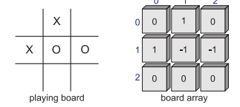
Tic-Tac-Toe board and the array representing it

Slide 36
Array Implementation of Linked Lists
1
2
3
4
5
6
7
8
9
10
Data
F
O
A
R
N
R
T
Next
3
8
6
4
-1
10
5
First = 2
How do we implement
Delete(position) ?
Insert(element, position)?

Slide 37
Free Cell Management
1
2
3
4
5
6
7
8
9
10
Data
F
O
A
R
N
R
T
Next
7
3
8
6
4
-1
9
10
0
5
First = 2
Free = 1
When an item is removed from the list, must “reclaim” the unused cell for later use
Can use same array to manage a second list of unused cells

Slide 38
Array Limitations
What are the limitations of an array, as a data structure?
Fixed size
Physically stored in consecutive memory locations
To insert or delete items, may need to shift data

Slide 39
Singly Linked Lists
A linked list, in its simplest form, is a collection of nodes that together form a linear ordering.
As in the children’s game “Follow the Leader,” each node stores a pointer, called next, to the next node of the list.
In addition, each node stores its associated element.
Example of a singly linked list of airport codes. The next pointers are shown as arrows. The null pointer is denoted by ∅.

Slide 40
The next pointer inside a node is a link or pointer to the next node of the list.
Moving from one node to another by following a next reference is known as link hopping or pointer hopping.
The first and last nodes of a linked list are called the head and tail of the list, respectively.
Thus, we can link-hop through the list, starting at the head and ending at the tail.

Slide 41
We can identify the tail as the node having a null next reference.
The structure is called a singly linked list because each node stores a single link.
Like an array, a singly linked list maintains its elements in a certain order, as determined by the chain of next links.
Unlike an array, a singly linked list does not have a predetermined fixed size. It can be resized by adding or removing nodes.

Slide 42
Implementing a Singly Linked List
Let us implement a singly linked list of strings.
We first define a class StringNode
The node stores two values, the member elem stores the element stored in this node, which in this case is a character string.
The member next stores a pointer to the next node of the list.
We make the linked list class a friend, so that it can access the node’s private members

Slide 43
class StringNode { // a node in a list of strings
private:
string elem; // element value
StringNode* next; // next item in the list
friend class StringLinkedList; // provide StringLinkedList access
};
This is an example of a node in a singly linked list of strings

Slide 44
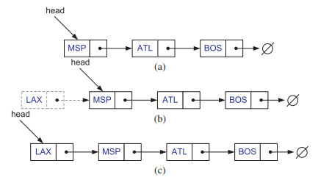
Insertion to the Front of a Singly Linked List
Insertion of an element at the head of a singly linked list: (a) before the insertion; (b) creation of a new node; (c) after the insertion.

Slide 45
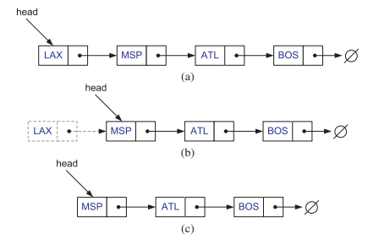
Removal from the Front of a Singly Linked List
Removal of an element at the head of a singly linked list: (a) before the removal; (b) “linking out” the old new node; (c) after the removal.

Slide 46
Nodes
A linked list is an ordered sequence of items called nodes
A node is the basic unit of representation in a linked list
A node in a singly linked list consists of two fields:
A data portion
A link (pointer) to the next node in the structure
The first item (node) in the linked list is accessed via a front or head pointer
The linked list is defined by its head (this is its starting point)

Slide 47
Singly Linked List
head pointer "defines" the linked list
(note that it is not a node)
head
these are nodes
.
data
data
data

Slide 48
Inserting a Node at the Front
node
node points to the new node to be inserted, front points to the first node of the linked list
front
node
Make the new node point to the first node (i.e. the node that front points to)
front

Slide 49
node
2. Make front point to the new node (i.e the node that node points to)
front

Slide 50
Inserting a Node in the Middle
node
Let's insert the new node after the third node in the linked list
front
insertion point
1. Locate the node preceding the insertion point , since it will have to be modified (make current point to it)
node
front
current

Slide 51
2. Make the new node point to the node after the insertion point (i.e. the node pointed to by the node that current points to)
node
front
current
node
3. Make the node pointed to by current point to the new node
front
X
current

Slide 52
Deleting the First Node
front points to the first node in the linked list, which points to the second node
front
Make front point to the second node (i.e. the node pointed to by the first node)
front
X

Slide 53
Deleting an Interior Node
front
previous
current
1. Traverse the linked list so that current points to the node to be deleted and previous points to the node prior to the one to be deleted
front
previous
current
2. We need to get at the node following the one to be deleted (i.e. the node pointed to by the node that current points to)

Slide 54
front
X
previous
current
3. Make the node that previous points to, point to the node following the one to be deleted

Slide 55
Linked List of Node Objects
linked list object
head
these are node objects
.
these are the data objects

Slide 56
Node Objects
For our linked list implementations, we will define a class called LinearNode to represent a node
It will be defined for the generic type T
Why is it a good idea to have separate node class?
Note that it is called “LinearNode” to avoid confusion with a different class that will define nodes for non-linear structures later

Slide 57
The LinearNode Class
Attributes (instance variables):
element: a reference to the data object
next : a reference to the next node
so it will be of type LinearNode
element
next
data object

Slide 58
Double-Ended Lists
Similar to an ordinary list with the addition that a link to the last item is maintained along with that to the first.
The reference to the last link permits to insert a new link directly at the end of the list as well as at the beginning.
This could not be done in the ordinary linked list without traversing the whole list.
This technique is useful in implementing the Queue where insertions are made at end and deletions from the front.

Slide 59
Double-Ended Lists
First
last
null

Slide 60
Doubly Linked Lists
Solves the problem of traversing backwards in an ordinary linked list.
A link to the previous item as well as to the next item is maintained.
The only disadvantage is that every time an item is inserted or deleted, two links have to be changed instead of one.
A doubly-linked list can also be created as a double – ended list.

Slide 61
Doubly Linked Lists
In a doubly linked list, each node has two links:
A reference to the next node in the list
A reference to the previous node in the list
What is the “previous” reference of the first node in the list?
What is the advantage of a doubly linked list?
What is a disadvantage?

Slide 62
Doubly Linked List
head
tail
.
.

Slide 63
Variations of Linked Lists
Doubly linked lists
Each node points to not only successor but the predecessor
There are two NULL: at the first and last nodes in the list
Advantage: given a node, it is easy to visit its predecessor. Convenient to traverse lists backwards
∅
A
B
C
∅
Head

Slide 64
Doubly Linked Lists
There is a type of linked list that allows us to go in both directions—forward and reverse—in a linked list.
It is the doubly linked list.
In addition to its element member, a node in a doubly linked list stores two pointers, a next link and a prev link, which point to the next node in the list and the previous node in the list, respectively.
Such lists allow for a great variety of quick update operations, including efficient insertion and removal at any given position.

Slide 65
Header and Trailer Sentinels
To simplify programming, it is convenient to add special nodes at both ends of a doubly linked list: a header node just before the head of the list, and a trailer node just after the tail of the list.
These “dummy” or sentinel nodes do not store any elements.
They provide quick access to the first and last nodes of the list.
In particular, the header’s next pointer points to the first node of the list, and the prev pointer of the trailer node points to the last node of the list.

Slide 66
A doubly linked list with sentinels, header and trailer, marking the ends of the list.
An empty list would have these sentinels pointing to each other.
We do not show the null prev pointer for the header nor do we show the null next pointer for the trailer.

Slide 67
Insertion into a Doubly Linked List
Because of its double link structure, it is possible to insert a node at any position within a doubly linked list.
Given a node v of a doubly linked list (which could possibly be the header, but not the trailer), let z be a new node that we wish to insert immediately after v.
Let w the be node following v, that is, w is the node pointed to by v’s next link.
(This node exists, since we have sentinels.) To insert z after v, we link it into the current list, by performing the following operations:

Slide 68
Make z’s prev link point to v
Make z’s next link point to w
Make w’s prev link point to z
Make v’s next link point to z
v points to the node JFK, w points to PVD, and z points to the new node BWI.
Observe that this process works if v is any node ranging from the header to the node just prior to the trailer.

Slide 69
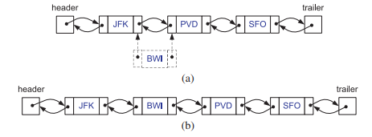
Adding a new node after the node storing JFK: (a) creating a new node with element BWI and linking it in; (b) after the insertion

Slide 70
Removal from a Doubly Linked List
Likewise, it is easy to remove a node v from a doubly linked list.
Let u be the node just prior to v, and w be the node just following v. (These nodes exist, since we have sentinels.)
To remove node v, we simply have u and w point to each other instead of to v.
We refer to this operation as the linking out of v.

Slide 71
We perform the following operations.
Make w’s prev link point to u
Make u’s next link point to w
Delete node v
v is the node PVD, u is the node JFK, and w is the node SFO.
Observe that this process works if v is any node from the header to the tail node (the node just prior to the trailer).

Slide 72
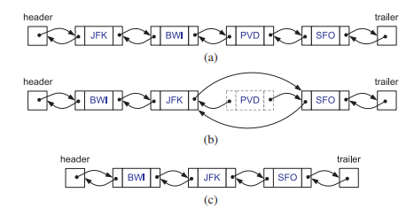
Removing the node storing PVD: (a) before the removal; (b) linking out the old node; (c) after node deletion

Slide 73
Circularly Linked Lists and List Reversal
A circularly linked list has the same kind of nodes as a singly linked list.
That is, each node in a circularly linked list has a next pointer and an element value.
But, rather than having a head or tail, the nodes of a circularly linked list are linked into a cycle.
If we traverse the nodes of a circularly linked list from any node by following next pointers, we eventually visit all the nodes and cycle back to the node from which we started.

Slide 74
Even though a circularly linked list has no beginning or end, we nevertheless need some node to be marked as a special node, which we call the cursor.
The cursor node allows us to have a place to start from if we ever need to traverse a circularly linked list.
There are two positions of particular interest in a circular list.

Slide 75
The first is the element that is referenced by the cursor, which is called the back, and the element immediately following this in the circular order, which is called the front.
Although it may seem odd to think of a circular list as having a front and a back, observe that, if we were to cut the link between the node referenced by the cursor and this node’s immediate successor, the result would be a singly linked list from the front node to the back node.

Slide 76
A circularly linked list. The node referenced by the cursor is called the back, and the node immediately following is called the front.

Slide 77
We define the following functions for a circularly linked list:
front(): Return the element referenced by the cursor; an error results if the list is empty.
back(): Return the element immediately after the cursor; an error results if the list is empty.
advance(): Advance the cursor to the next node in the list.

Slide 78
add(e): Insert a new node with element e immediately after the cursor; if the list is empty, then this node becomes the cursor and its next pointer points to itself.
remove(): Remove the node immediately after the cursor (not the cursor itself, unless it is the only node); if the list becomes empty, the cursor is set to null.

Slide 79
Variations of Linked Lists
Circular linked lists
The last node points to the first node of the list
How do we know when we have finished traversing the list? (Tip: check if the pointer of the current node is equal to the head.)
A
B
C
Head

Slide 80
Recursion
We have seen that repetition can be achieved by writing loops, such as for loops and while loops.
Another way to achieve repetition is through recursion, which occurs when a function refers to itself in its own definition

Slide 81
Linear Recursion
The simplest form of recursion is linear recursion, where a function is defined so that it makes at most one recursive call each time it is invoked.
This type of recursion is useful when we view an algorithmic problem in terms of a first or last element plus a remaining set that has the same structure as the original set.

Slide 82
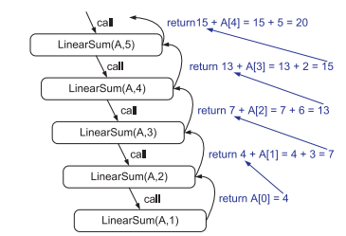
Recursion trace for an execution of LinearSum(A,n) with input parameters A = {4,3,6,2,5} and n = 5.

Slide 83
Binary Recursion
When an algorithm makes two recursive calls, we say that it uses binary recursion.
Recursion trace for the execution of BinarySum(0,8).

Slide 84
Multiple Recursion
Generalizing from binary recursion, we use multiple recursion when a function may make multiple recursive calls, with that number potentially being more than two.
One of the most common applications of this type of recursion is used when we want to enumerate various configurations in order to solve a combinatorial puzzle

Slide 85
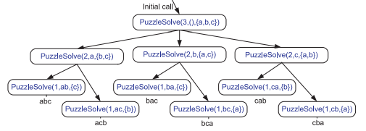
Recursion trace for an execution of PuzzleSolve(3,S,U), where S is empty and U = {a,b,c}.
This execution generates and tests all permutations of a, b, and c. We show the permutations generated directly below their respective boxes.

Slide 86
THE END

